Slide 1

DriverPass System Analysis
By : David Waid
Notes:
[No speaker notes required for this slide.]

Slide 2

System Requirements
functional requirements:
Add, remove, and update packages
Take online classes and practice test
NonFunctional requirements:
Usability
Maintainability
Notes:
[In your speaker notes, include an explanation of the different requirements you determined for DriverPass’s system. What are the functional requirements you selected to describe? What are the nonfunctional requirements you selected to describe? Be sure to explain how these requirements meet DriverPass’s needs.]
For the system requirements we have two types of requirements. The two types are nonfunctional, things like how easy the system is to use, how fast is the system, and so forth. One the other we have functional requirements which are what actual things can the system we built do. For DriverPass they wanted the system to do many things like being able to update the information you study based on the most current information that the DMV has. This is why we have the abililty to add, remove, and update the information. They also want to provide the customer with access to online classes, and practice exams. These functional requirements help guide us to the nonfunctional requirements. For those functions we want to ensure our system is easy to maintain since we will constantly need to update it due to changing information. We also need this system to have great usability, because the most important thing with any system is being able to actually use it easily and not being confused. The last thing someone learning should have to worry about is learning the system they are using.

Slide 3
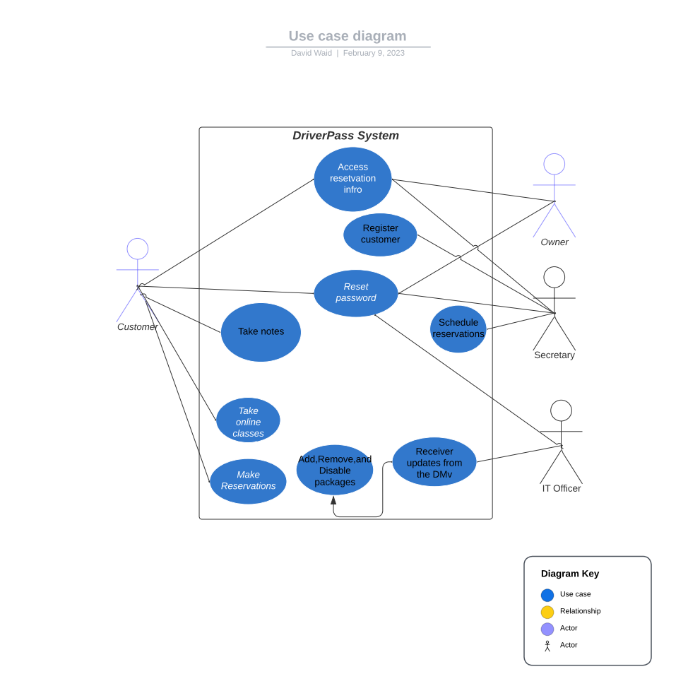
Use Case Diagram
Notes:
[Explain your diagram. Who are the different actors in the system? What are the different use cases? How did you account for DriverPass’s needs in your design? In your explanation, keep your audience in mind. Avoid the use of terms like “actors” and “use cases” in your explanation.]
The use case diagram is a diagram that will show us who will be using our system and what hat different reasons the people will be using the system. As the diagram shows we will have our customer, IT Officer, secretary, and owner as people who will use the system. The lines will show you all reasons that said person will use the the program.

Slide 4
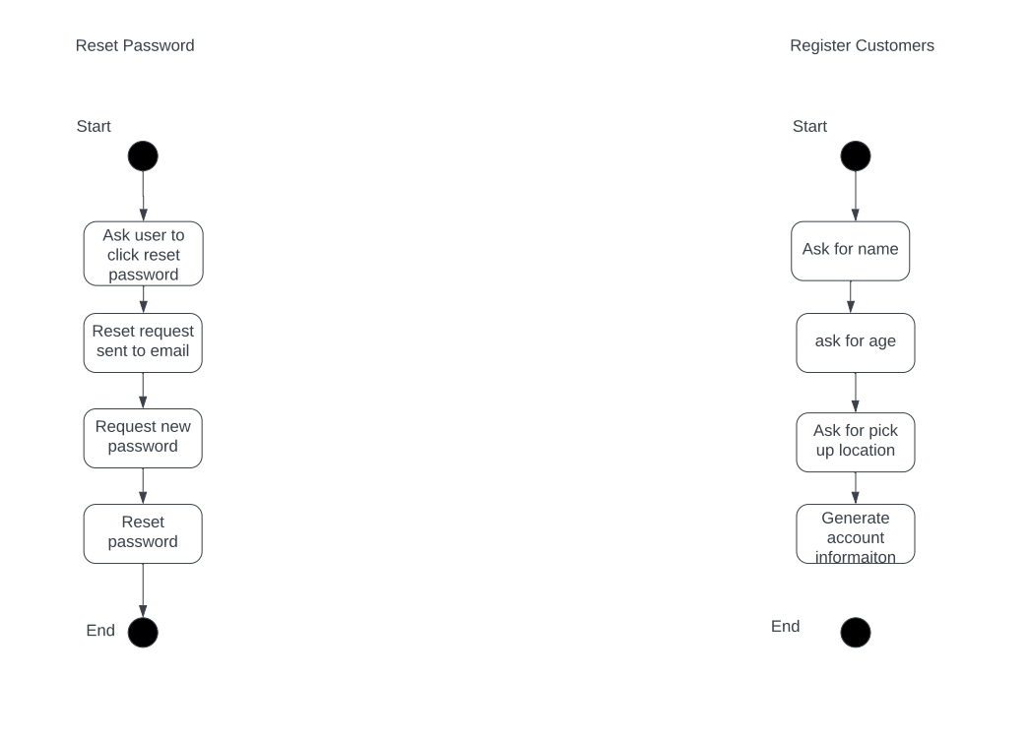
Activity Diagram
[Insert one of your activity diagrams here.]
Notes:
[Explain your diagram. Which use case are you breaking down? What are the steps for this use case? How did you account for DriverPass’s needs in your design? In your explanation, keep your audience in mind. Avoid the use of technical terms such as “nodes,” “control flows,” and so on.]
For the activity diagram, we will get a breakdown of a process within our system and the steps that will be taken from beginning to end. These activities are shown the process that driver pass wanted to have within the program. We took the process they want and break it down step by step to show the functionalityality

Slide 5
Security
We will utilize cloud-based servers for the security of our customers
Notes:
[How did you consider security in your design? In your explanation, keep your audience in mind by avoiding the use of technical terms.]
When we talked with DriverPass they told us that security was not something they wanted to deal with themselves. This is because they wished for more time to deal with running the business. For this reason we will be using cloud-based servers, and that way the security will be dealt with by a cloud-based server.

Slide 6
System Limitations
Budget
Resources
Notes:
[What are the limitations of your design? In your explanation, keep your audience in mind by avoiding the use of technical terms.]
When we think of limitations we want to think of things that will affect our success in creating a great product. The thing that we want to really worry about is budgeting because the budget will affect everything else. This single limitation can change the nonfunctional, and functional requirements.

